Slide 1
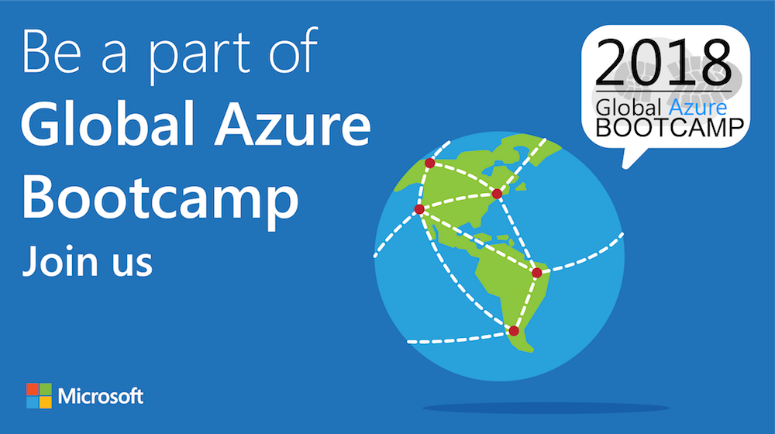

Slide 2
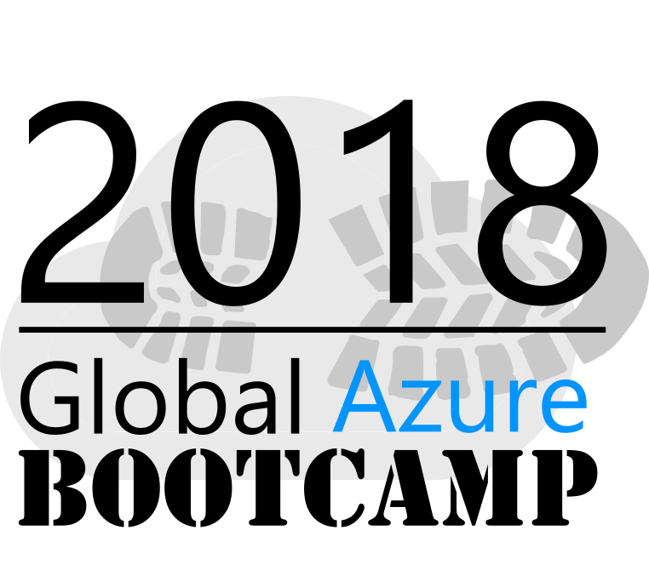
Welcome to the
{Curitiba - PR}

Slide 3

Sponsors & Prices

Slide 4
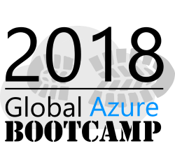







A BIG thank you to the 2018 Global Sponsors!

Slide 5


Another BIG thank you to local sponsors!

Slide 6


All attendees get the following:
Sponsor | Offering
Cloudmonix https://cloudmonix.com | Cloudmonix offers a $300 off any paid plan for Azure monitoring! http://bit.ly/gab2018-cloudmonix Code: GAB2018
MyGet https://myget.org | MyGet offers a free 1 month Starter Plan for hosting your NuGet, npm, Maven, Bower of VSIX feeds! http://bit.ly/gab2018-myget Code: GGAB2018-MG
ServiceBus360 https://servicebus360.com | Servicebus360 is offering 2 months free of their Gold Plan! http://bit.ly/gab2018-sb360
Cerebrata https://cerebrata.com | Cerebrata is providing a 3 month subscription to it’s Cerulean product! Get your subscription key from your organizer!
Offers valid until April 30th

Slide 7


Raffle Prizes
1 Winner: a 1 year personal subscription of the All Products Pack. Get all desktop products including IntelliJ IDEA Ultimate, ReSharper Ultimate and other IDEs
1 Winner: a 1 year subscription to Cerulean! A cross-platform Azure management tool for storage, CosmosDB, Search, Redis Cache and Service Bus.
1 Winner: a 1 year subscription to their online training, Skill Me Up! Online training to continue your Azure journey.
Raffle winners will receive a voucher with a code from the local organizers.

Slide 8


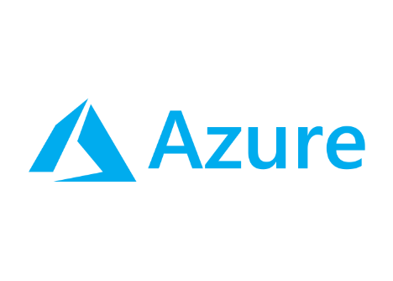
Como o AIP pode manter meus dados seguros?
Bruno Lopes
Technical Trainer & MVP Microsoft
Wipro do Brasil
Curitiba

Slide 9
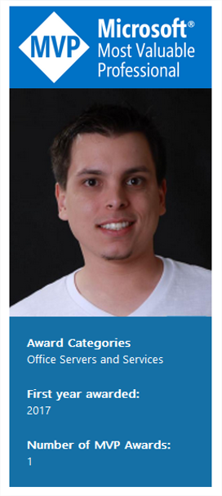




Technical Trainer e Engenheiro de Suporte no Frontline Microsoft (vendor Wipro).
Especialista em infraestrutura, com foco em Exchange Server, Office 365,
Skype for Business e Azure. MTAC Lead na região Sul do Brasil.
@brunokktro
FanPage: /blogdolopez
https://www.linkedin.com/in/blopesinfo
http://bit.ly/Youtube_BlogLopez

Slide 10





Enterprise Mobility + Security
The Microsoft vision
Identity Driven Security
Managed Mobile Productivity
Users
Devices
Apps
Data
Comprehensive Solution

Slide 11











Enterprise Mobility +Security
The Microsoft solution
Azure Active Directory
Manage identity with hybrid integration to protect application access from identity attacks
Microsoft Cloud App Security
Extend enterprise-grade security to your cloud and SaaS apps
Intune
Advanced Threat Analytics
Azure Information Protection
Protect your data, everywhere
Protect your users, devices, and apps
Detect threats early with visibility and threat analytics

Slide 12
Azure Information Protection

Slide 13
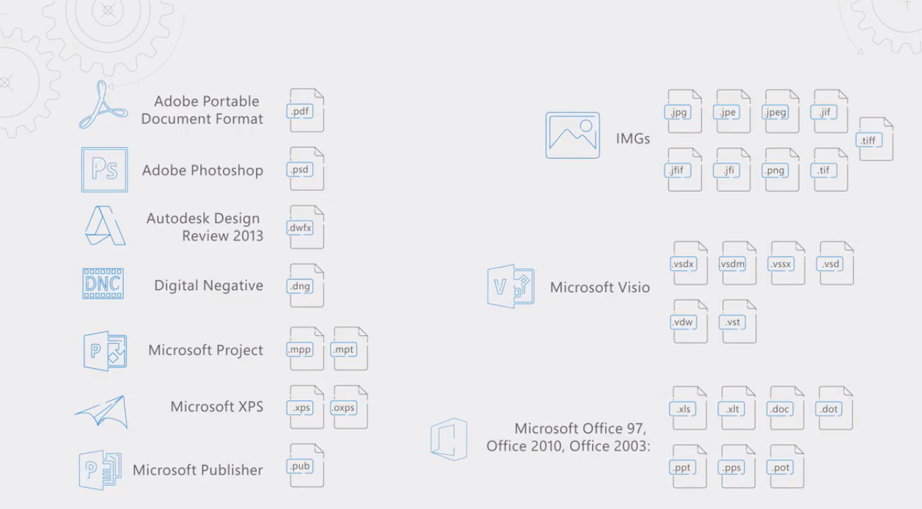

Slide 14



How much control do YOU have?
Unregulated, unknown
Hybrid data = new normal
It is harder to protect
Identity, device management protection
Managed mobile environment
Perimeter protection
On-premises

Slide 15

The evolution of Information Protection
CLASSIFICATION
LABELING
ENCRYPTION
ACCESS CONTROL
POLICY ENFORCEMENT
DOCUMENT TRACKING
DOCUMENT REVOCATION
Classify & Label
Protect
Monitor & Respond

Slide 16
Azure Information Protection
Full Data Lifecycle
CLASSIFICATION
LABELING
ENCRYPTION
ACCESS CONTROL
POLICY ENFORCEMENT
DOCUMENT TRACKING
DOCUMENT REVOCATION
Classify & Label
Protect
Monitor & Respond

Slide 17
Classification
+ Automation
+ Protection
+ Reporting
+ Collaboration

Slide 18
Classification

Slide 19
Classify Data – Begin the Journey
Classify data based on sensitivity
Start with the data that is most sensitive
IT can set automatic rules; users can complement it
Associate actions such as visual markings and protection
IT admin sets policies,
templates, and rules
Confidential
Restricted
Personal
Internal
Public

Slide 20
Classification user experiences
Automatic
Recommended
Reclassification
Manual

Slide 21

Apply Labels based on classification
Persistent labels that travel with the document
Labels are metadata written to documents
Labels are in clear text so that other systems such as a DLP engine can read
Labels travel with the document, regardless of location
FINANCE
CONFIDENTIAL

Slide 22
Protection

Slide 23






Protect data against unauthorized use
Corporate apps
FILE
VIEW
EDIT
COPY
PASTE
Email
attachment
Personal apps
Protect data needing protection by:
Encrypting data
Including authentication requirement and a definition of use rights (permissions) to the data
Providing protection that is persistent and travels with the data

Slide 24
How Protection Works
Usage rights and symmetric key stored in file as “license”
License protected by customer-owned RSA key
Use rights +
Water
Sugar
Brown #16
Water
Sugar
Brown #16
aEZQAR]ibr{qU@M]BXNoHp9nMDAtnBfrfC;jx+Tg@XL2,Jzu
()&(*7812(*:
PROTECT
UNPROTECT
Each file is protected by a unique AES symmetric
Secret cola formula

Slide 25


How Protection Works
LOCAL PROCESSING ON PCS/DEVICES
Use rights +
Azure RMS never sees the file content, only the license
SDK
Use rights +
aEZQAR]ibr{qU@M]BXNoHp9nMDAtnBfrfC;jx+Tg@XL2,Jzu
()&(*7812(*:
File content is never sent to the RMS server/service
Apps protected with RMS enforce rights
Apps use the SDK to communicate with the RMS service/servers
Rights Management Active Directory Key Vault

Slide 26
Demo
Azure Information Protection
Notes:
What is Azure Information Protection?
https://docs.microsoft.com/en-us/azure/information-protection/understand-explore/what-is-information-protection
Quick start tutorial for Azure Information Protection
https://docs.microsoft.com/en-us/azure/information-protection/get-started/infoprotect-quick-start-tutorial

Slide 27
Reporting

Slide 28


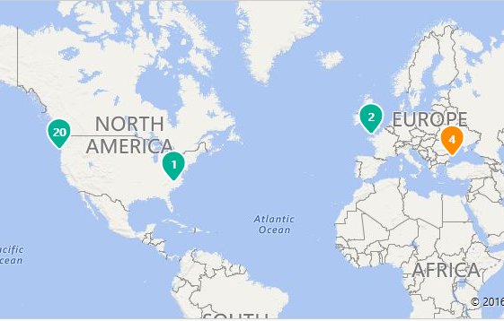




Monitor and Respond
Monitor use, control and block abuse
Bob
MAP VIEW
Sue
Jane
Sue
Jane
Competitors
Bob accessed from North America
Jane access is revoked
Jane accessed from France
Joe blocked in Ukraine
Notes:
https://portal.azurerms.com/#/admin

Slide 29
Collaboration

Slide 30





Road to sharing data safely with anyone
Share internally, with business partners, and customers
Internal user
Let Bob view and print
Let Jane edit and print
*******
LoB
Any device/
any platform
Bob
File share
SharePoint
Sue
Email
Jane
External user
*******

Slide 31
How Sharing Works
Using Azure AD for authentication
On-premises organizations doing full sync
Azure Active Directory
On-premises organizations doing partial sync
Organizations completely in cloud
Organizations created through ad-hoc signup
…and all of these organizations can interact with each other.
ADFS

Slide 32
Architectures

Slide 33

Topology
optional
Azure AD
Azure Rights Management
Azure Key Management
Data protection for organizations at different stages of cloud adoption
Ensures security because sensitive data is never sent to the RMS server
Integration with on-premises assets with minimal effort
Authentication & collaboration
Service supplied Key
BYOK
Authorization requests via federation
(optional)
RMS connector
AAD Connect
ADFS

Slide 34
Topology for
Regulated Environments
optional
Azure AD
Azure Rights Management
Azure Key Management
Data protection for organizations at different stages of cloud adoption
Ensures security because sensitive data is never sent to the RMS server
Integration with on-premises assets with minimal effort
Hold your key on premises
Authentication & collaboration
Service supplied Key
BYOK
Authorization requests via federation
(optional)
RMS connector
AAD Connect
ADFS
Rights Management
Key Management
HYOK

Slide 35
Getting started with key scenarios
Classification only
Understand your data classification needs, enable the service and define a default policy so all documents are labelled.
+ Automation
Define content based actions to automatically classify and label documents or make recommendations to users to confirm.
+ Protection
For sensitive information, define protection policies that require authentication and enforce use rights.
+ Reporting
Gain insights into the types of information you have, users that work with different sensitivity levels and trends in data creation.
+ Collaboration
Securely share documents and email with internal and external recipients.

Slide 36
Keep going…
Try Enterprise Mobility + Security for free, today:
www.microsoft.com/en-us/cloud-platform/enterprise-mobility-trial
See Microsoft Cloud App Security in action
https://www.microsoft.com/en-us/cloud-platform/cloud-app-security-trial
Evaluate and try Microsoft Advanced Threat Analytics now www.microsoft.com/en-us/evalcenter/evaluate-microsoft-advanced-threat-analytics
Explore Identity + Access Management www.microsoft.com/en-us/cloud-platform/identity-management
Learn more about Azure Information Protection www.microsoft.com/en-us/cloud-platform/information-protection
Discover new MDM and MAM solutions with Microsoft Intune www.microsoft.com/en-us/cloud-platform/mobile-device-managementlink
Check out new Desktop virtualization capabilities www.microsoft.com/en-us/cloud-platform/desktop-virtualization

Slide 37

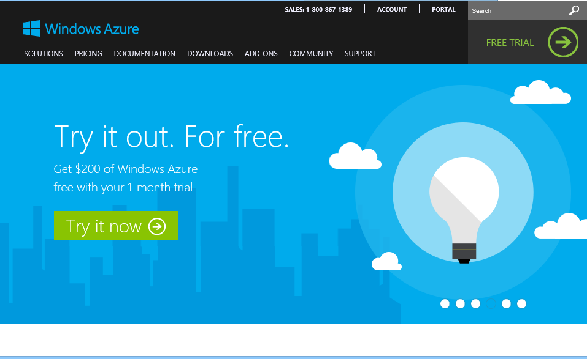
Comece agora.
http://WindowsAzure.com

Slide 38
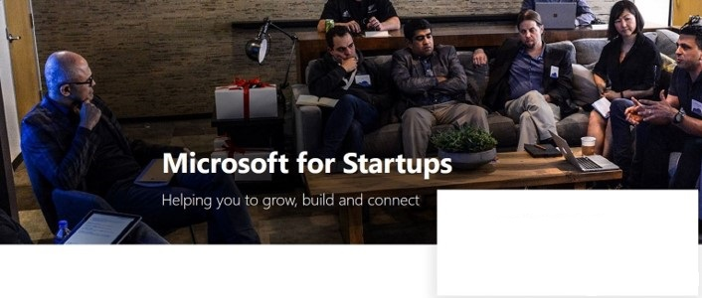
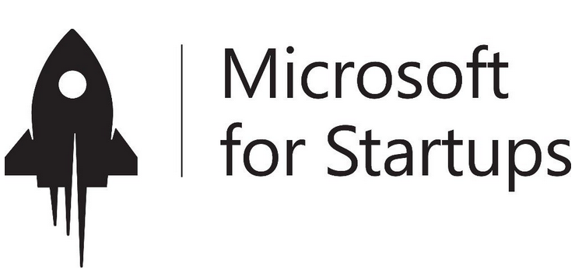
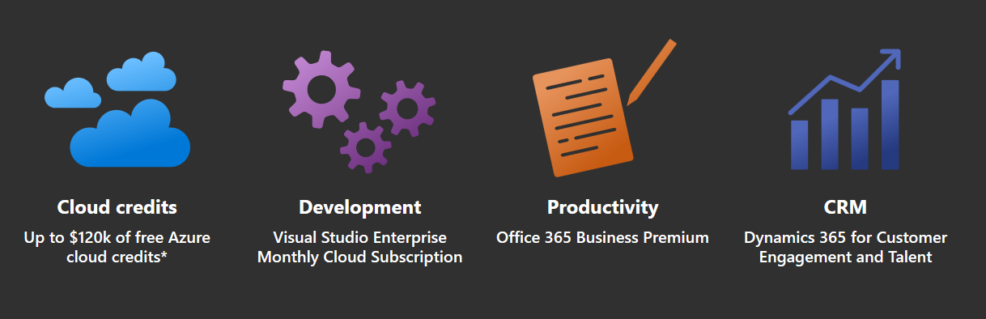
Microsoft 4 Startups
https://startups.microsoft.com
Notes:
Microsoft for Startup é o substituto do antigo “Microsoft BizSpark”.

